Slide 1

PROJECT EXHIBITION - II
Review – Final Review

Slide 2
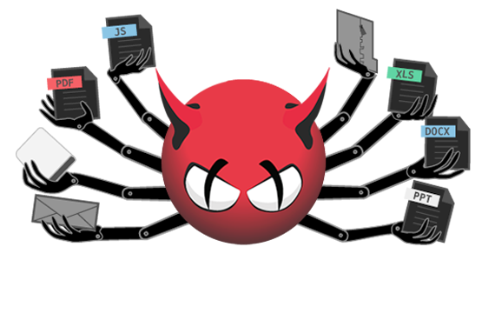

Malvealer – A Malware detector

Slide 3


Project Guide/Reviewer
Reviewer – Dr. Amrendra Singh Yadav Sir
Assistant Professor
VIT Bhopal University
Guide – Dr. Subhash Chandra Patel Sir
Assistant Professor
VIT Bhopal University

Slide 4




The Team
Harish Carpentar
20MEI10027
Divyansh ojha
20MEI10028
Narendra Kumar Patel
20MEI10039
Akshay Chouke
20MEI10044

Slide 5
Malware – Introduction
Installation
when a user clicks on a link, downloads a malicious attachment or opens a rogue software program.
1
Work
attackers can use the malware to spy on your online activities, steal personal and financial information or use your device to hack other systems.
2

Slide 6
Malware Detection Techniques
Signature detection –
In this method a unique identifier about the threat is stablished.
With this identifier threat can be identified and detected.
In virus scan this identifier is Unique code template that attached to a file.
If this pattern or signature rediscovered ,the file may reported as infected.

Slide 7
Malware Detection Techniques
2. Behaviour detection –
It includes “Heuristic Scan”.
Heuristic scan uses Algorithms to search for commands that may indicate intent evil.
With the help of this scan we can easily scan malware files without a signature.
Combination of these two methods(signature, Heuristic scan) used by antivirus to capture any malware.

Slide 8
Malware Detection Techniques
3. Feature detection –
It is derivation of behaviour-based detection.
This involves monitoring program executions and detecting deviations from the specific and its behaviour,instead of seemingly selecting specific attack patterns.
This technique is similar to the detection of anomalies,different,being that it is based on features developed manually to capture the behaviour of the system instead of relying on ML techniques.
The advantage of this technique is that it can instantly detect known and unknown malware and the level of false positive is lower but the level of fase negatives is high and not as effective as behavioural detection.

Slide 9





Existing Work With Limitations
Existing work –
Best malware detector software’s –
Limitations –
Protection limited on Android, more so on iOS.
Advanced firewall features absent.
Many useful features require upgrade.
Parental content filter can’t handle HTTPS in many popular browsers.
Full VPN access requires separate subscription.
Support for iOS extremely limited.
Parental control unavailable on macOS.
Online backup strictly for Windows.
Security protection limited on iOS devices.

Slide 10
Proposed work and Methodology
We have developed Malvealer using Python and Machine learning Algorithms.
We have used signature based detection method to detect the Malware. In this Method we are having a dataset and from that dataset we are matching the files. Dataset contain so many Malware files to detect the Malware.
We have used Regression and Clustering Modules for grouping the data in same category and identifying the contiguous values.

Slide 11
Novelty Of Project
GUI based
Highly efficient
Reliable
Easily detects malware

Slide 12
Real Time Usage
We can use Malvealer for detecting the Malware inside the directory or file.
Also we can handle the Malware by removing that Malware from the directory after Scanning it.
Malvealer basically can be used to be Secure against any Malicious activity that can be happen in our system.

Slide 13

Hardware and Software Requirements
Hardware Requirements –
Processor: Minimum 1 GHz; Recommended 2.42GHz or more​.
Hard Drive: Minimum 64GB; Recommended 128 or more.​
Memory (RAM): Minimum 2 GB; Recommended 4 GB or above.
Software Requirements –
Software Proper Installation or Console or GUI Environment store in System ..​
Python 3.6/3.7 ​
​

Slide 14
Implementation and Coding

Slide 15
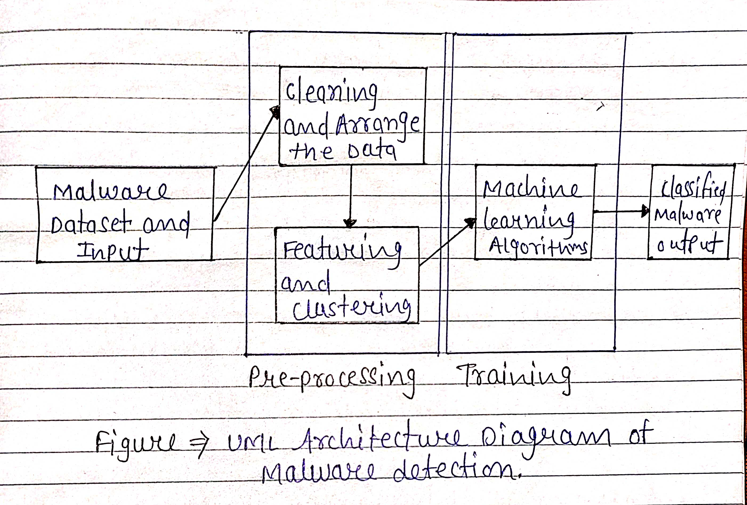
Overall Architecture Diagram and Flow Diagram

Slide 16
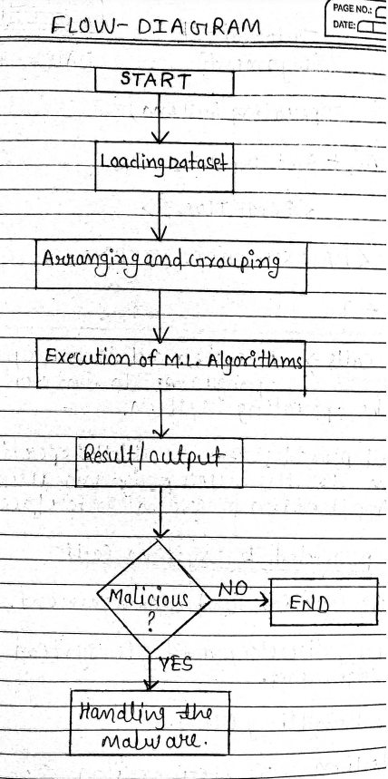
Overall Architecture Diagram and Flow Diagram

Slide 17

Complete Module split-up and Explanation
PRE-PROCESSING MODULE
REGRESSION MODULE
CLASSIFICATION MODULE
CLUSTERING MODULE

Slide 18
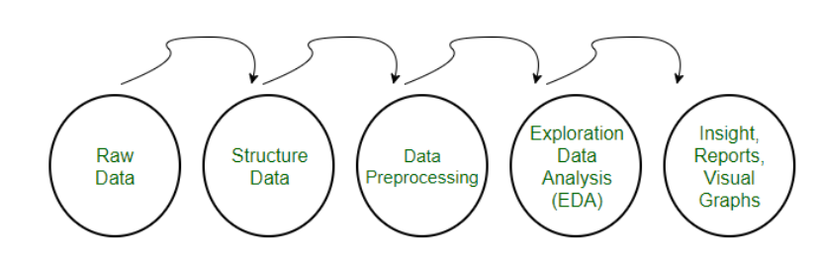
Complete Module split-up and Explanation
Data Preprocessing Module- used to convert the raw data into a clean data set. In other words, whenever the data is gathered from different sources it is collected in raw format which is not feasible for the analysis.
Need of Data Preprocessing • The format of the data has to be in a proper manner. Some specified Machine Learning model needs information in a specified format.
for example, Random Forest algorithm does not support null values, therefore to execute random forest algorithm null values have to be managed from the original raw data set. • Another aspect is that data set should be formatted in such a way that more than one Machine Learning and Deep Learning algorithms are executed in one data set, and best out of them is chosen.

Slide 19
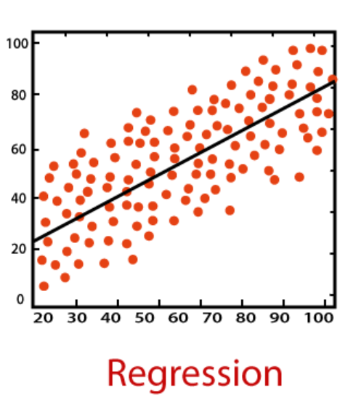
Complete Module split-up and Explanation
Regression Module - Regression algorithms are used to predict the continuous values such as price, salary, age, etc.

Slide 20
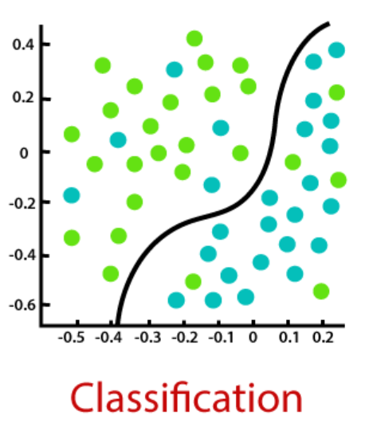
Complete Module split-up and Explanation
Classification Module - algorithms are used to predict/Classify the discrete values such as Male or Female, True or False, Spam or Not Spam, etc.

Slide 21
Complete Module split-up and Explanation
Clustering Module –
Clustering is quite literally the clustering or grouping up of data according to the similarity of data points and data patterns.
The aim of this is to separate similar categories of data and differentiate them into localized regions.
This way, when a new data point arrives, we can easily identify which group or cluster it belongs to. This is done for unstructured datasets where it is up to the machine to figure out the categories.

Slide 22
Result and Discussion
In future we can add more functionalities to the tool like when a new file is coming in our pc our tool will automatically search for malware in that file and also we can increase the dataset . If Malware found than our tool can easily handle the Malware.
We can Implement Cloud based Verdict platform so that we can identify Malware immediately. Cloud based verdict Platform provides Real time analysis. If the code matches any of codes listed in the platform, it means that the file is malicious.
Another Feature we can add Fileless Malware protection also. Fileless malware is the most dangerous type of malware because it directly attacks the central part of the operating system. So it is important to choose an anti malware software that protects the computer against fileless malware. Some examples of fileless malware are VBscript and Powershell.

Slide 23

Testing
We have tested our program for different-different directories that are present in our system.
We have scanned the directories and updated the directories after removing the Malwares.

Slide 24
Conclusion
As we know malware is trending threat and it is very harmful for the systems. Attackers can use malware and they can access our system. It is very much required to handle the malwares. Malvealer is designed to detect the malware in directory and files.
The aim of this tool is to detect and remove malware from the file.

Slide 25
DEMO VIDEO

Slide 26
Used resources / References
RESEARCH ARTICLE | AUTHOR
A state-of-the-art survey of malware detection approaches using data mining techniques | Alireza Souri
Malware Analysis and Vulnerability Detection Using Machine Learning | Farrukh A. Khan
Tools and Techniques for Malware Detection and Analysis | Sajedul Talukder
Techniques of Malware Detection: Research Review | Institute of Electrics and Electronics Engineering
Malware and Malware Detection Techniques: A Survey | Jyoti Landage
https://www.av-test.org/en/statistics/malware/ | AVTEST site report
https://www.researchgate.net/publication/343499527_Project_report_Malware_analysis | Research Gate site report
https://intellipaat.com/community/41644/what-is-the-difference-between-regression-and-clustering

Slide 27
THANK YOU!
Open for Questions!

